Slide 1
Indexing Time Series

Slide 2
Time Series Databases
A time series is a sequence of real numbers, representing the measurements of a real variable at equal time intervals
  Stock prices
  Volume of sales over time
  Daily temperature readings
  ECG data
A time series database is a large collection of time series

Slide 3
Time Series Data
A time series is a collection of observations made sequentially in time.
25.1750
25.1750
25.2250
25.2500
25.2500
25.2750
25.3250
25.3500
25.3500
25.4000
25.4000
25.3250
25.2250
25.2000
25.1750
..
..
24.6250
24.6750
24.6750
24.6250
24.6250
24.6250
24.6750
24.7500
29
28
27
value
axis
26
25
24
23
0
50
100
150
200
250
300
350
400
450
500
time axis

Slide 4
Time Series Problems
(from a database perspective)
The Similarity Problem
X = x₁, x₂, …, x_{n} and Y = y₁, y₂, …, y_{n}
Define and compute Sim(X, Y)
  E.g. do stocks X and Y have similar movements?
Retrieve efficiently similar time series (Indexing for Similarity Queries)

Slide 5
Types of queries
whole match vs sub-pattern match
range query vs nearest neighbors
all-pairs query

Slide 6
Examples
Find companies with similar stock prices over a time interval
Find products with similar sell cycles
Cluster users with similar credit card utilization
Find similar subsequences in DNA sequences
Find scenes in video streams

Slide 7
$price
$price
1
365
day
$price
1
365
day
distance function: by expert
(eg, Euclidean distance)
1
365
day

Slide 8
Problems
Define the similarity (or distance) function
Find an efficient algorithm to retrieve similar time series from a database
  (Faster than sequential scan)
The Similarity function depends on the Application

Slide 9
Metric Distances
What properties should a similarity distance have?
D(A,B) = D(B,A) Symmetry
D(A,A) = 0 Constancy of Self-Similarity
D(A,B) >= 0 Positivity
D(A,B) ≤ D(A,C) + D(B,C) Triangular Inequality

Slide 10
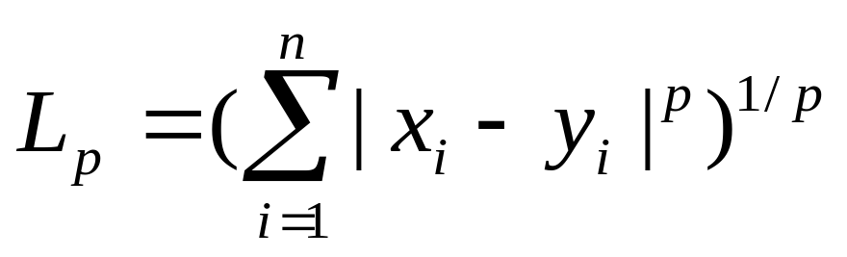
Euclidean Similarity Measure
View each sequence as a point in n-dimensional Euclidean space (n = length of each sequence)
Define (dis-)similarity between sequences X and Y as
p=1 Manhattan distance
p=2 Euclidean distance

Slide 11
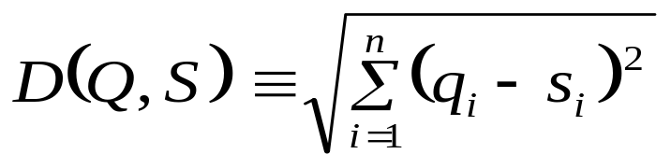
Euclidean model
Query Q
Database
Distance
Rank
0.98
4
n datapoints
0.07
1
Euclidean Distance between
two time series Q = {q₁, q₂, …, q_{n}}
and S = {s₁, s₂, …, s_{n}}
Q
0.21
2
S
0.43
3
n datapoints

Slide 12
Advantages
Easy to compute: O(n)
Allows scalable solutions to other problems, such as
  indexing
  clustering
  etc...

Slide 13
Dynamic Time Warping
[Berndt, Clifford, 1994]
Allows acceleration-deceleration of signals along the time dimension
Basic idea
  Consider X = x₁, x₂, …, x_{n} , and Y = y₁, y₂, …, y_{n}
  We are allowed to extend each sequence by repeating elements
  Euclidean distance now calculated between the extended sequences X’ and Y’
  Matrix M, where m_{ij} = d(x_{i}, y_{j})

Slide 14
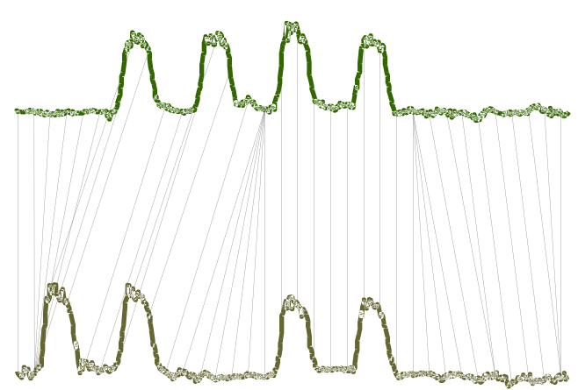
Example
Euclidean distance vs DTW

Slide 15
Dynamic Time Warping
[Berndt, Clifford, 1994]
j = i + w
warping path
j = i – w
Y
y3
y2
y1
x1
x2
x3
X

Slide 16
Restrictions on Warping Paths
Monotonicity
  Path should not go down or to the left
Continuity
  No elements may be skipped in a sequence
Warping Window
  | i – j | <= w

Slide 17
Formulation
Let D(i, j) refer to the dynamic time warping distance between the subsequences
  x₁, x₂, …, x_{i}
  y₁, y₂, …, y_{j}
D(i, j) = | x_{i} – y_{j} | + min { D(i – 1, j),
  D(i – 1, j – 1),
  D(i, j – 1) }

Slide 18
Solution by Dynamic Programming
Basic implementation = O(n²) where n is the length of the sequences
  will have to solve the problem for each (i, j) pair
If warping window is specified, then O(nw)
  Only solve for the (i, j) pairs where | i – j | <= w

Slide 19
Longest Common Subsequence Measures
(Allowing for Gaps in Sequences)
Gap skipped

Slide 20
Basic LCS Idea
  X = 3, 2, 5, 7, 4, 8, 10, 7
  Y = 2, 5, 4, 7, 3, 10, 8, 6
  LCS = 2, 5, 7, 10
  Sim(X,Y) = |LCS| or Sim(X,Y) = |LCS| /n
Edit Distance is another possibility

Slide 21

Similarity Retrieval
Range Query
  Find all time series S where
Nearest Neighbor query
  Find all the k most similar time series to Q
A method to answer the above queries: Linear scan … very slow
A better approach GEMINI

Slide 22
GEMINI
Solution: Quick-and-dirty' filter:
extract m features (numbers, eg., avg., etc.)
map into a point in m-d feature space
organize points with off-the-shelf spatial access method (‘SAM’)
retrieve the answer using a NN query
discard false alarms

Slide 23
GEMINI Range Queries
Build an index for the database in a feature space using an R-tree
Algorithm RangeQuery(Q, ε)
  Project the query Q into a point q in the feature space
  Find all candidate objects in the index within ε
  Retrieve from disk the actual sequences
  Compute the actual distances and discard false alarms

Slide 24
GEMINI NN Query
Algorithm K_NNQuery(Q, K)
  Project the query Q in the same feature space
  Find the candidate K nearest neighbors in the index
  Retrieve from disk the actual sequences pointed to by the candidates
  Compute the actual distances and record the maximum
  Issue a RangeQuery(Q, εmax)
  Compute the actual distances, return best K

Slide 25
GEMINI
GEMINI works when:
  D_{feature}(F(x), F(y)) <= D(x, y)
  Proof. (see book)
Note that, the closer the feature distance to the actual one, the better.

Slide 26
Problem
How to extract the features? How to define the feature space?
Fourier transform
Wavelets transform
Averages of segments (Histograms or APCA)
Chebyshev polynomials
.... your favorite curve approximation...

Slide 27
Fourier transform
DFT (Discrete Fourier Transform)
Transform the data from the time domain to the frequency domain
highlights the periodicities
SO?

Slide 28
DFT
A: several real sequences are periodic
Q: Such as?
A:
  sales patterns follow seasons;
  economy follows 50-year cycle (or 10?)
  temperature follows daily and yearly cycles
Many real signals follow (multiple) cycles

Slide 29
How does it work?
Decomposes signal to a sum of sine and cosine waves.
Q:How to assess ‘similarity’ of x with a (discrete) wave?
value
x ={x₀, x₁, ... x_{n-1}}
s ={s₀, s₁, ... s_{n-1}}
time
0
1
n-1

Slide 30
How does it work?
A: consider the waves with frequency 0, 1, ...; use the inner-product (~cosine similarity)
Freq=1/period
value
value
freq. f=0
freq. f=1 (sin(t * 2 π/n) )
time
time
0
1
n-1
0
1
n-1

Slide 31
How does it work?
A: consider the waves with frequency 0, 1, ...; use the inner-product (~cosine similarity)
value
freq. f=2
time
0
1
n-1

Slide 32
How does it work?
‘basis’ functions
0
1
n-1
cosine, f=1
sine, freq =1
0
n-1
0
1
n-1
1
cosine, f=2
sine, freq = 2
0
1
n-1
0
1
n-1

Slide 33
How does it work?
Basis functions are actually n-dim vectors, orthogonal to each other
‘similarity’ of x with each of them: inner product
DFT: ~ all the similarities of x with the basis functions

Slide 34
How does it work?
Since e^{jf} = cos(f) + j sin(f) (j=sqrt(-1)),
we finally have:

Slide 35
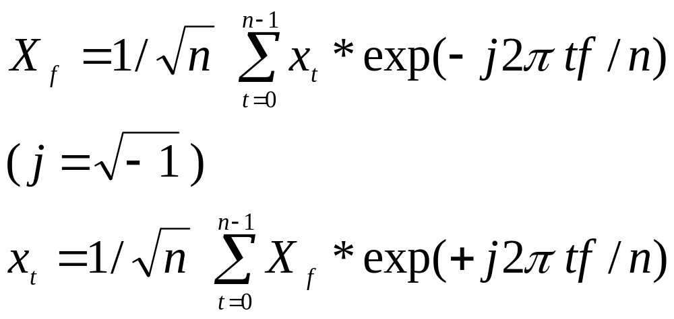
DFT: definition
Discrete Fourier Transform (n-point):
inverse DFT

Slide 36
DFT: properties
Observation - SYMMETRY property:
X_{f} = (X_{n-f} )*
( “*”: complex conjugate: (a + b j)* = a - b j )
Thus we use only the first half numbers

Slide 37
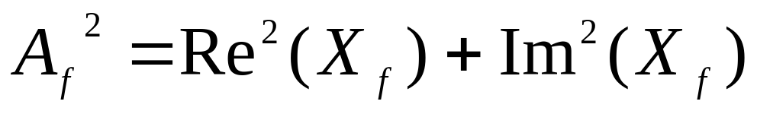
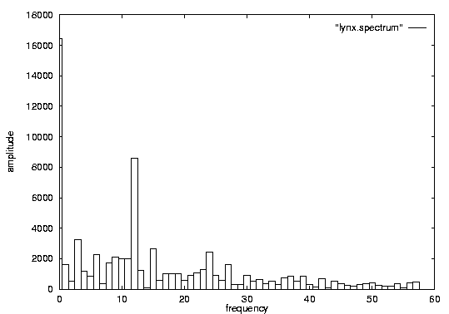
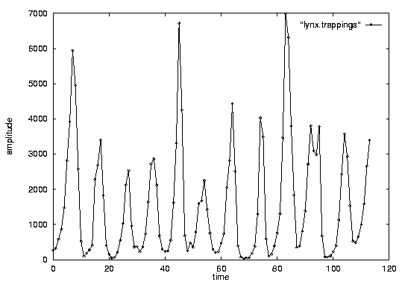
DFT: Amplitude spectrum
Amplitude
Intuition: strength of frequency ‘f’
count
A_{f}
freq: 12
time
freq. f

Slide 38
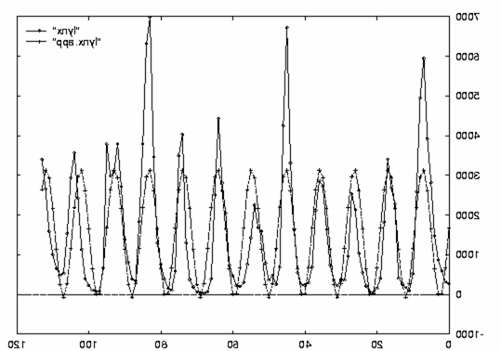
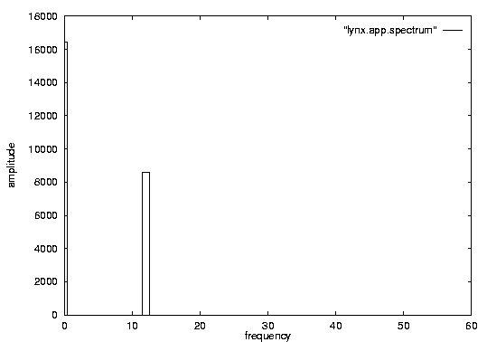
DFT: Amplitude spectrum
excellent approximation, with only 2 frequencies!
so what?

Slide 39
Raw
Data
0.4995
0.5264
0.5523
0.5761
0.5973
0.6153
0.6301
0.6420
0.6515
0.6596
0.6672
0.6751
0.6843
0.6954
0.7086
0.7240
0.7412
0.7595
0.7780
0.7956
0.8115
0.8247
0.8345
0.8407
0.8431
0.8423
0.8387
…
The graphic shows a time series with 128 points.
The raw data used to produce the graphic is also reproduced as a column of numbers (just the first 30 or so points are shown).
C
0
20
40
60
80
100
120
140
n = 128

Slide 40
Raw
Data
Fourier
Coefficients
We can decompose the data into 64 pure sine waves using the Discrete Fourier Transform (just the first few sine waves are shown).
The Fourier Coefficients are reproduced as a column of numbers (just the first 30 or so coefficients are shown).
C
0.4995
0.5264
0.5523
0.5761
0.5973
0.6153
0.6301
0.6420
0.6515
0.6596
0.6672
0.6751
0.6843
0.6954
0.7086
0.7240
0.7412
0.7595
0.7780
0.7956
0.8115
0.8247
0.8345
0.8407
0.8431
0.8423
0.8387
…
1.5698
1.0485
0.7160
0.8406
0.3709
0.4670
0.2667
0.1928
0.1635
0.1602
0.0992
0.1282
0.1438
0.1416
0.1400
0.1412
0.1530
0.0795
0.1013
0.1150
0.1801
0.1082
0.0812
0.0347
0.0052
0.0017
0.0002
...
0
20
40
60
80
100
120
140
. . . . . . . . . . . . . .

Slide 41

Truncated
Fourier
Coefficients
Raw
Data
Fourier
Coefficients
C
0.4995
0.5264
0.5523
0.5761
0.5973
0.6153
0.6301
0.6420
0.6515
0.6596
0.6672
0.6751
0.6843
0.6954
0.7086
0.7240
0.7412
0.7595
0.7780
0.7956
0.8115
0.8247
0.8345
0.8407
0.8431
0.8423
0.8387
…
1.5698
1.0485
0.7160
0.8406
0.3709
0.4670
0.2667
0.1928
0.1635
0.1602
0.0992
0.1282
0.1438
0.1416
0.1400
0.1412
0.1530
0.0795
0.1013
0.1150
0.1801
0.1082
0.0812
0.0347
0.0052
0.0017
0.0002
...
1.5698
1.0485
0.7160
0.8406
0.3709
0.4670
0.2667
0.1928
n = 128
N = 8
C_{ratio} = 1/16
C’
0
20
40
60
80
100
120
140
We have discarded
of the data.

Slide 42
Sorted
Truncated
Fourier
Coefficients
Raw
Data
Fourier
Coefficients
C
0.4995
0.5264
0.5523
0.5761
0.5973
0.6153
0.6301
0.6420
0.6515
0.6596
0.6672
0.6751
0.6843
0.6954
0.7086
0.7240
0.7412
0.7595
0.7780
0.7956
0.8115
0.8247
0.8345
0.8407
0.8431
0.8423
0.8387
…
1.5698
1.0485
0.7160
0.8406
0.3709
0.1670
0.4667
0.1928
0.1635
0.1302
0.0992
0.1282
0.2438
0.2316
0.1400
0.1412
0.1530
0.0795
0.1013
0.1150
0.1801
0.1082
0.0812
0.0347
0.0052
0.0017
0.0002
...
1.5698
1.0485
0.7160
0.8406
0.2667
0.1928
0.1438
0.1416
C’
0
20
40
60
80
100
120
140
Instead of taking the first few coefficients, we could take the best coefficients

Slide 43
DFT: Parseval’s theorem
sum( x_{t} ² ) = sum ( | X _{f} | ² )
Ie., DFT preserves the ‘energy’
or, alternatively: it does an axis rotation:
x1
x = {x0, x1}
x0

Slide 44
Lower Bounding lemma
Using Parseval’s theorem we can prove the lower bounding property!
So, apply DFT to each time series, keep first 3-10 coefficients as a vector and use an R-tree to index the vectors
R-tree works with euclidean distance, OK.

